Slide 1
AWS Serverless Data Analytics
Lecturer: Ngo Huy Bien
Software Engineering Department
Faculty of Information Technology
University of Science
Ho Chi Minh City, Vietnam
nhbien@fit.hcmus.edu.vn

Slide 2

Objectives

Slide 3

Contents

Slide 4

References

Slide 5
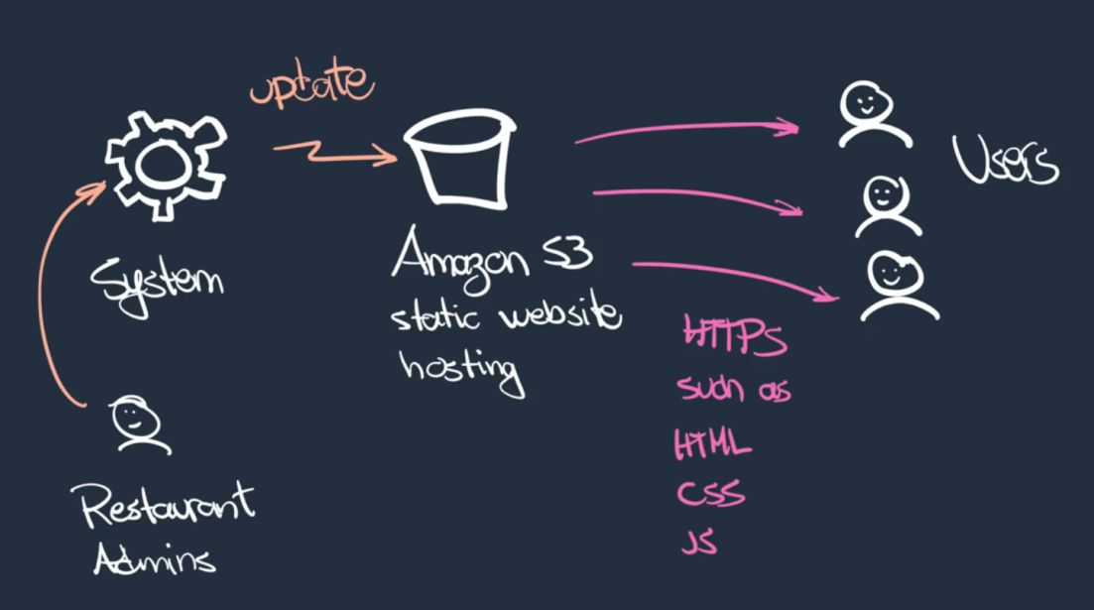
Use Case and Pain Points
Issue: no analytics → no forecasting.

Slide 6
Requirements
Need: forecasting.

Slide 7

Thank You & See You Again

